Slide 1

Slide 1
Supermarket Sales Analysis
Presentation

Slide 2
Slide 2
SUPERMARKET SALES - CONTENT PAGE
1. Description of dataset
2. data understanding, eda, and transformation – data cleaning process
3. Visual analytics and feature engineering – graphs and observations
4. report & design – power Bi
5. communication and storytelling – comments and analysis
2

Slide 3
Description of dataset
This dataset used in this presentation shows the sales performance of 3 supermarket branches (a, b & c) in Myanmar (Yangon, Naypyitaw, mandalay). The dataset has time covers the first quarter of 2019. The dataset has a size of 1000 rows.
general observations of the data:
a. Sales and performance by branch, product, time
b. Gender demographics and trends
c. Modes of payment
d. Product analysis
e. Key influencers

Slide 4
DATA DICTIONARY
Invoice ID: Unique identifier for each transaction.
Branch: Store branch where the sale occurred (A, B, C).
City: City where the branch is located (Yangon, Naypyitaw, Mandalay).
Customer type: Type of customer (Member, Normal).
Gender: Gender of the customer (Male, Female).
Product line: Category of the product sold (Health and beauty, Electronic accessories, etc.).
Unit price: Price per unit of the product.
Quantity: Number of units purchased.
Tax 5%: Tax applied to the sale.
Total: Total sale amount (including tax).
Date: Date of the transaction.
Year: Year of the transaction
Month: Month of the transaction
Time: Time of the transaction
Hour: Hour of the transaction
Payment: Payment method used (Ewallet, Cash, Credit card).
COGS: Cost of goods sold.
Gross margin percentage: Gross margin percentage for the sale.
Gross income: Gross income from the sale.
Rating: Customer rating for the transaction.
YTD_Sales: Sales MEASURE from that start of the year until last date in the data

Slide 5
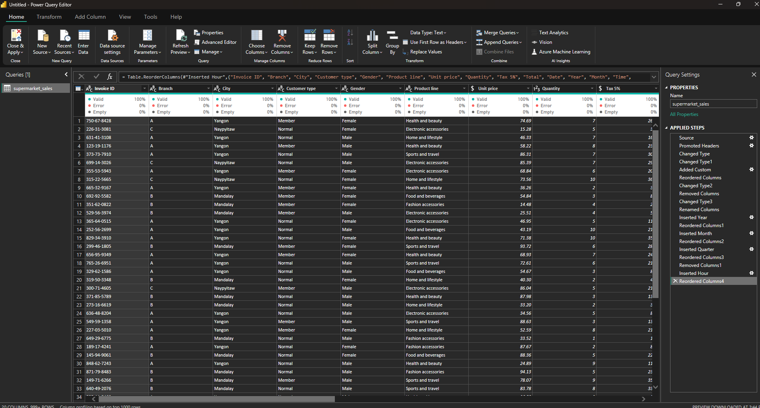
DATA quality

Slide 6
DATA Transformation
Data had no null values, duplicate values or error values
only 1 data table so no relationships had to be built with other tables
In the transformation page the following data was adjusted:
Date type for date data (changed regional setting to usa)
Change currency type for all cash related data (price, tax, total, cogs)
Amended gross margin percentage to % type as previous data format was decimal
Added new columns for year, month, and hour
Added new measure for ytd sales in model view

Slide 7
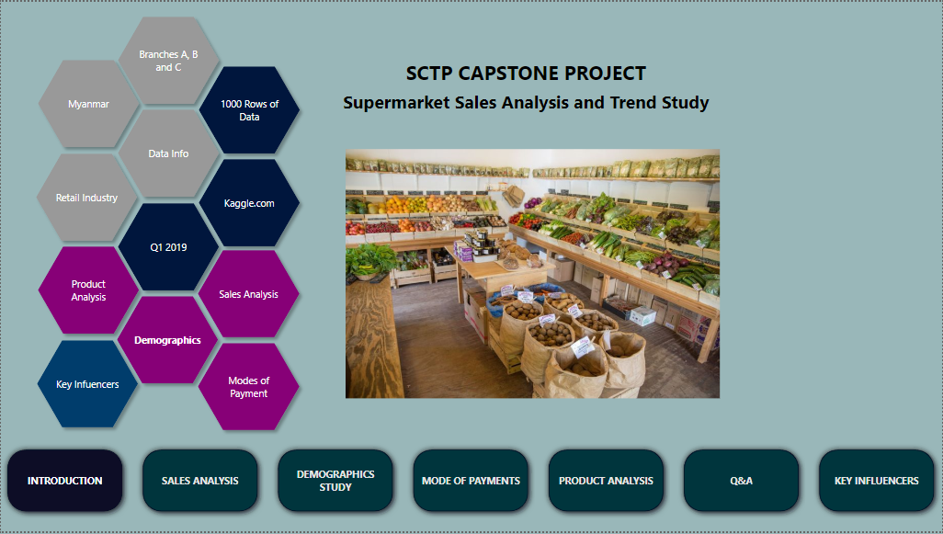

Slide 8
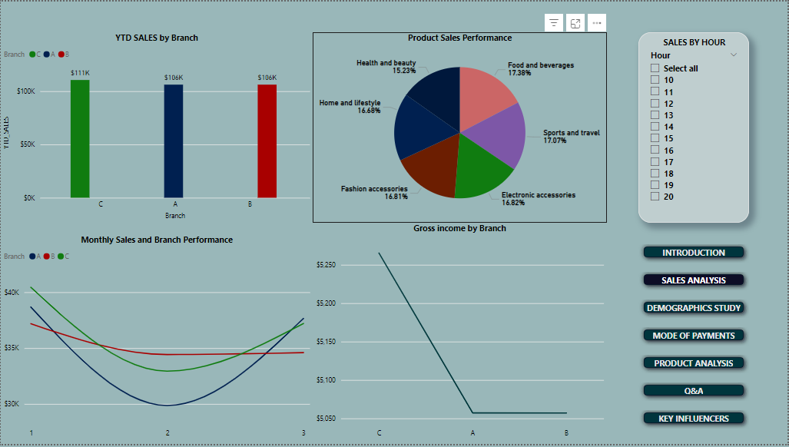
Sales analysis

Slide 9
Key points – Sales Analysis
Bar Chart (YTD Sales by Branch)
Branch C has the highest sales at $111K
Pie Chart (sales performance by product categories):
Food and beverage holds the biggest market share following closely by sports and travel
Health and beauty holds the smallest market share
Line graph (Monthly sales performance for the branches)
Branch A and Branch C shows a dip in the second month and a recover in the third
Branch b has shown stable sales performance

Slide 10
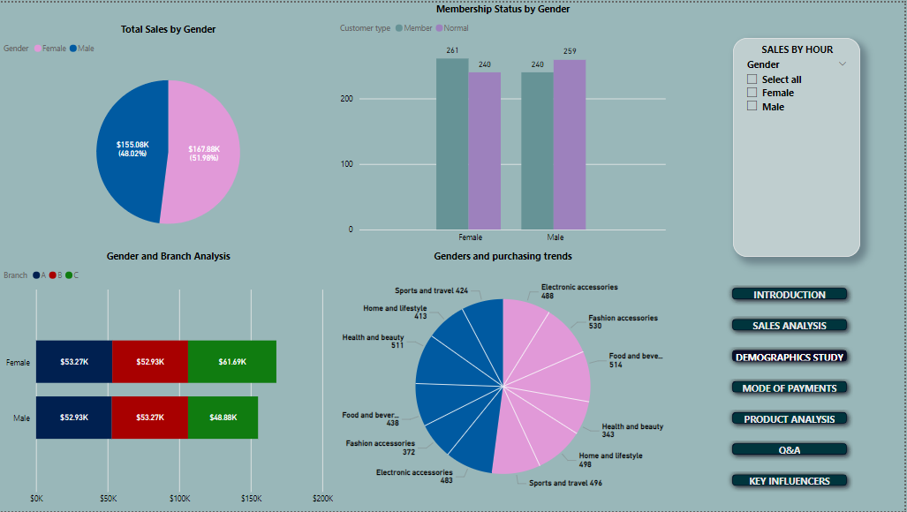
Gender demographics study

Slide 11
Key points – Gender demographics
Pie Chart (Total sales by gender)
Females make up the bigger sales amount at 51.98%
Bar Chart (Membership status by gender)
The number of members seem fairly even in both genders
The number of non members is even at 240 each
Stacked bar graph (Gender and branch analysis)
Females have spent more at branch c
Males have spent more at branch b
Pie chart (Gender and purchasing analysis)
Females have bought more fashion products and least on health and beauty
Males have bought more health and beauty products and least on fashion

Slide 12
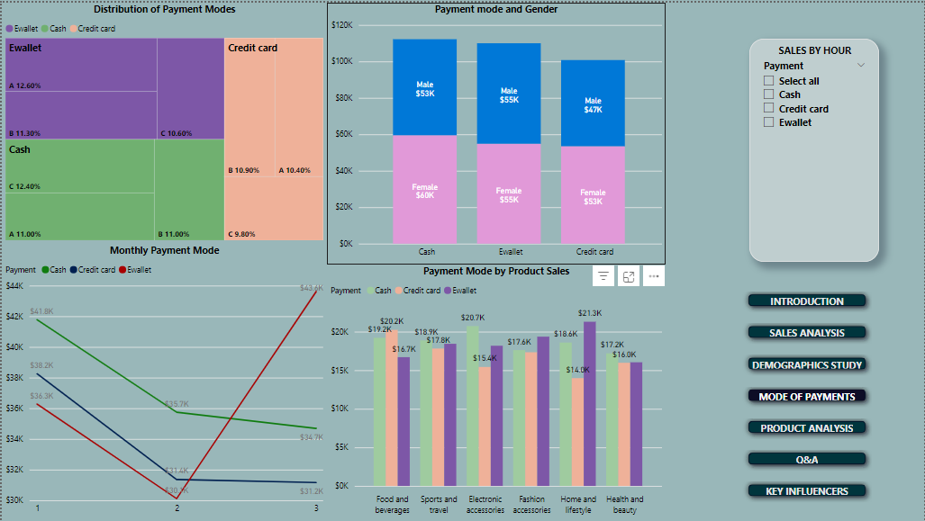
Mode of payments

Slide 13
Key points – Payment mode
Treemap (distribution of payment modes)
Ewallet most used in branch a and least branch c
Cash most used in branch a and evenly used in branches b and c
Credit card most used in branch b and least in branch c
Bar Chart (Payment mode and gender)
Females have used cash transaction the most
Males have used ewallet transactions the most
Line graph (monthly payment mode analysis)
drastic decrease in cash and credit card transactions
drastic increase in ewallet transactions
Pie chart (Gender and purchasing analysis)
Cash mostly used mode for purchasing products
Credit card least used mode for purchasing products

Slide 14
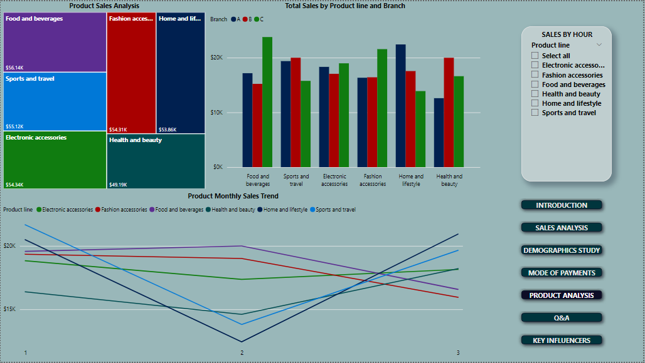
Product analysis

Slide 15
Key points – Product analysis
Treemap (Product Sales Analysis)
The treemap displays the total sales for various product lines
Food and beverages have the highest sales, followed closely by Sports and travel, Electronic accessories, and Fashion accessories. Health and beauty have the lowest sales
Bar Chart (Sum of Total by Product Line and Branch Chart)
The bar chart compares the total sales for each product line across three branches
Branch A has the highest sales in Home and lifestyle
Branch B has the highest sales in Fashion accessories.
Branch C has the highest sales in Food and beverages.
Sales in Health and beauty are relatively lower across all branches

Slide 16
Key points – Product analysis
Line Chart (Product Monthly Sales Trend)
The line chart shows the monthly sales trend for each product line
The sales for Food and beverages and Sports and travel show a declining trend
Fashion accessories, Home and lifestyle, and Health and beauty show an upwards trend in sales after month 2

Slide 17
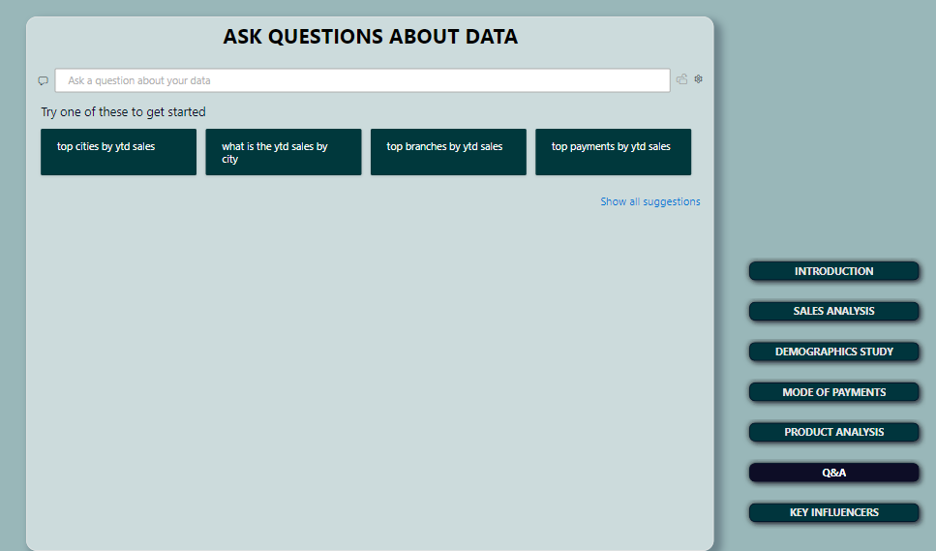

Slide 18
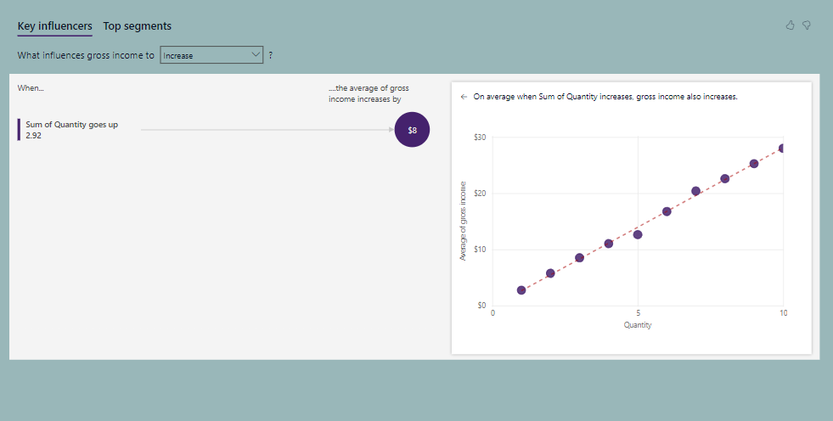

Slide 19
professional analysis and comments
Investigate cost structures and identify inefficiencies or higher costs that may be impacting gross income. Implement cost-saving measures or optimize operations to improve profitability
For Branches A and C, develop strategies to stabilize sales, such as consistent promotional activities or customer engagement initiatives. Consider analyzing the factors causing the dips and addressing them proactively.
Share best practices and successful strategies across branches. Encourage branches to adopt similar tactics to improve performance in weaker areas. Conduct training sessions to ensure all branches are equipped with the knowledge and tools to succeed due to certain branches performing better than others
Investigate cause of decline in food and beverages, could be due to increased competition, prices or products
Continue current promotion/marketing campaigns for sports and travel, home and lifestyle, health and beauty, however branch c has to improve
implement strategies to balance sales across genders in Branch C, such as targeted promotions or adjusting product offerings based on gender preferences
Implement targeted marketing strategies to further increase membership among both genders
Implement promotions and incentives, such as cashback or reward points, to encourage more customers to use credit cards
Educate customers on the benefits of using multiple payment methods to avoid over-dependence on Ewallets
Offer tailored promotions for different payment methods in specific product lines

Slide 20
Others - professional analysis and comments
Electronics - Look into warranty & servicing features, offer, up to date latest models
All product lines – look into working with influencers and various brand ambassadors to improve sales
Run events or certain fun challenges in the supermarket to attract customers and remain relevant, rewards or points system may be awarded or not free prizes could be given out (old inventory that needs to be pushed out FIFO)
Start the option of online marketplace or e commerce via an app or collaborating with other brands and offer products to be delivered or pick up in store options
Due to the high dependance on ewallet, invest on tightening security features to ensure data is encrypted and protected
Gross profit margin can be improved on, so retail prices should be revised or COGS can be reduced by ordering inventory in bulk
Rating of different supermarkets constantly fluctuate, look to improve on service quality, cleanliness, ambience and etc. improved ratings may attract more potential customers

Slide 21

Slide 11
THANK YOU

